Slide 1
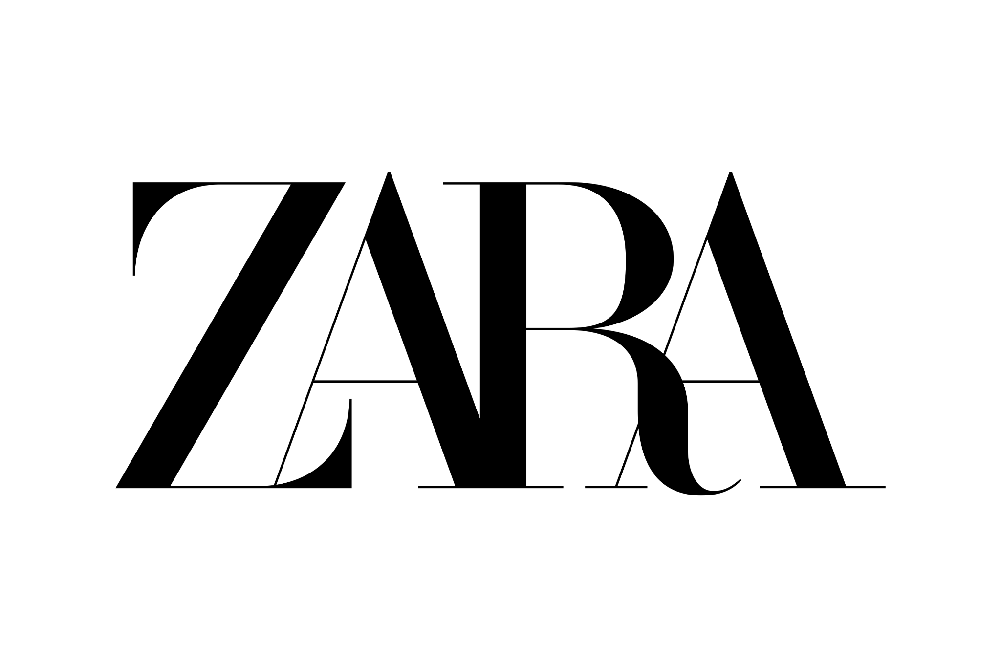
ZARA MARKET STRATEGY
Combining Consumer Insights & Advertising Strategies
Team Kanyaraasi
Notes:
Good [morning/afternoon] everyone, Thank you for being here today. We’re excited to present our analysis of Zara’s Market Strategy. Over the next few minutes, we’ll walk you through how Zara’s business model, customer insights, and advertising strategy align—and where improvements can be made to strengthen customer engagement and increase market share.
Let’s dive in.

Slide 2
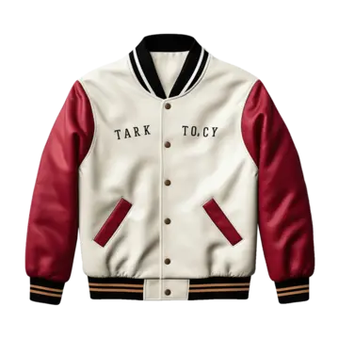
ABOUT ZARA
Founded: 1975 in Spain
Parent Company: Inditex group
Global Presence: Over 7000 Stores in 96 Countries
Unique Selling Proposition: Fast Fashion Model - delivers new designs in 2 weeks.
Positioning: Affordable luxury with a focus on trends and fast production cycles
Collaborators: Vertically Integrated Supply Chain
Notes:
Zara was founded in 1975 in Spain and is part of the Inditex Group—one of the largest fashion retailers in the world. Zara operates over 7,000 stores across 96 countries, making it one of the most globally recognized names in fashion.
Zara’s unique fast fashion model allows it to deliver new designs from concept to store in just two weeks—much faster than traditional fashion cycles. This gives Zara a strong competitive advantage in staying on top of trends.
Zara’s market positioning is "affordable luxury"—offering premium-looking styles at competitive prices. Its vertically integrated supply chain enables faster production and lower costs.
However, this model creates challenges. High inventory turnover pressures Zara to maintain stock levels and respond quickly to trends, which raises concerns about sustainability. Balancing speed, affordability, and sustainability will be key to Zara’s long-term success.

Slide 3
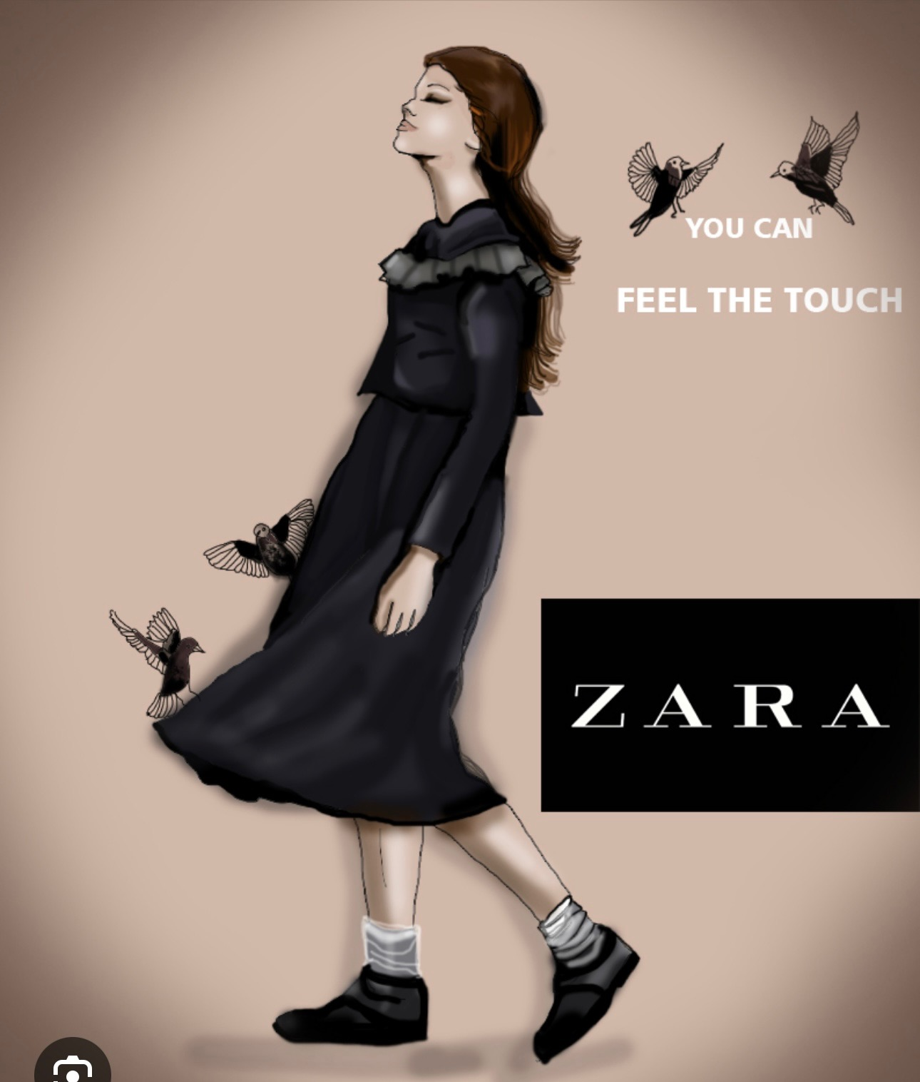
5C ANALYSIS - COMPANY,CONTEXT, COLLABORATORS
Through the 5C framework, we identified Zara’s key strengths and challenges:
Company: Fast supply chain and vertical integration create cost efficiency and trend adaptability.
Context: The rise of sustainable fashion and digital shopping requires Zara to adapt its strategy to meet changing customer expectations.
Collaborators: Strong partnerships with suppliers and logistics partners support Zara’s rapid production and distribution model.
Zara’s ability to adapt to these shifts while maintaining its fast-fashion edge will define its future success.

Slide 4
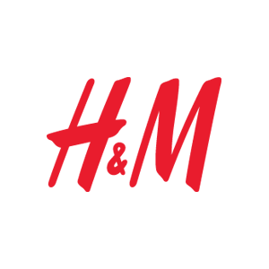
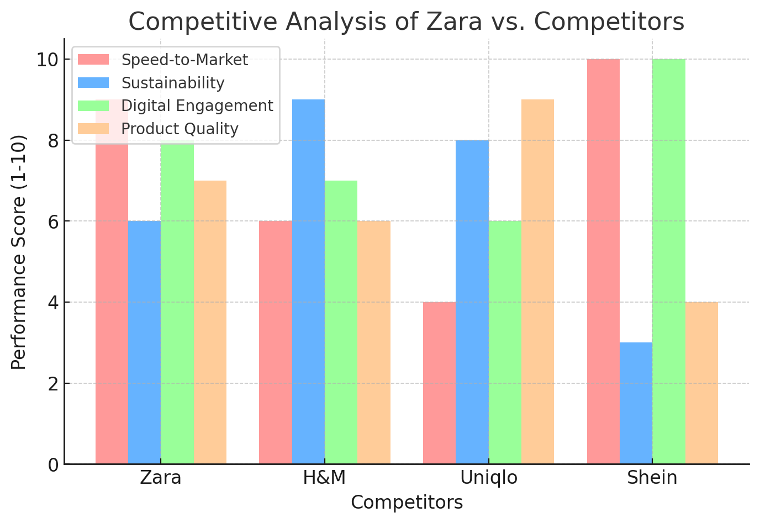
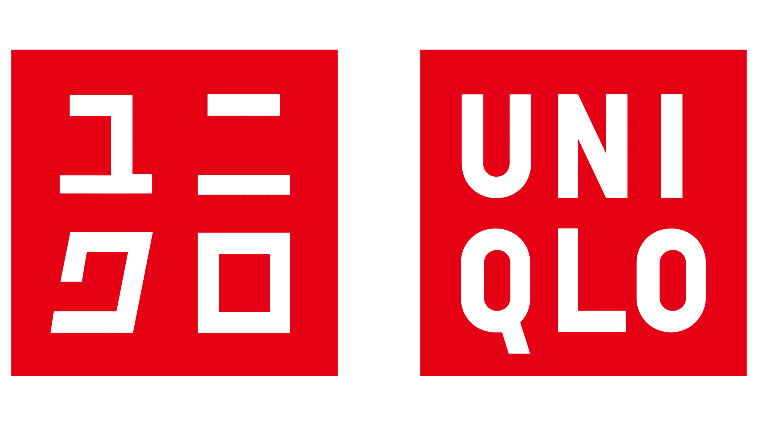
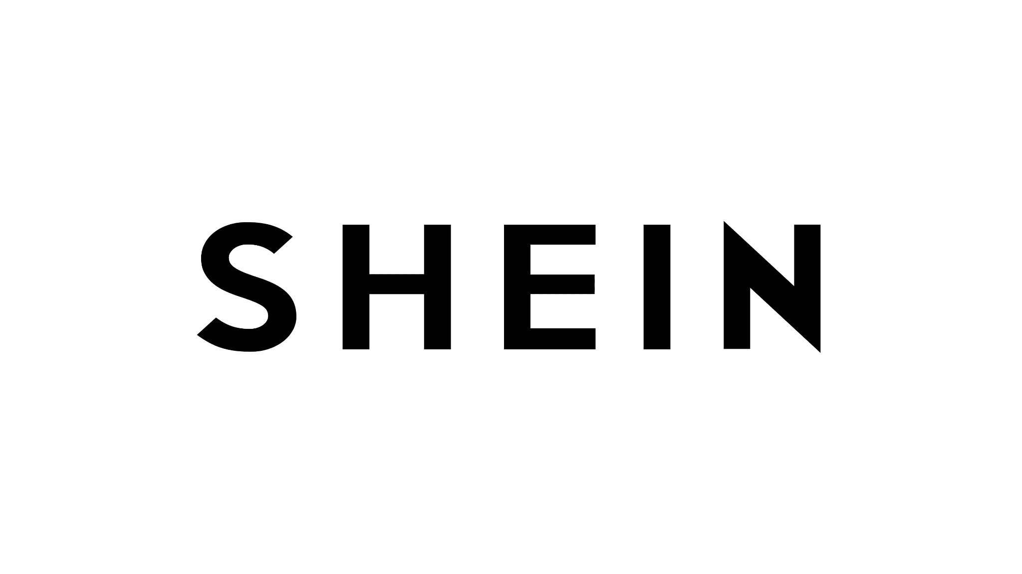
5C ANALYSIS - COMPETITORS
Notes:
Zara operates in a highly competitive market.
Let’s start with H&M. H&M has built a strong brand around affordability and sustainability. Their resale programs and circular fashion initiatives appeal to eco-conscious buyers.
Next is Uniqlo. Uniqlo differentiates itself through a focus on quality and fabric innovation. Their HeatTech and AIRism technologies have created a loyal customer base that values comfort and durability over fast-changing styles.
Then there’s Shein, Zara’s most aggressive competitor. Shein’s strength lies in its ultra-fast product turnover and aggressive pricing. Its digital-first approach has allowed it to capture a large portion of the online market, especially among Gen Z shoppers.
Zara’s competitive edge lies in combining speed and style with a premium look. However, Zara will need to reinforce its value proposition—balancing affordability and sustainability—while responding to the competitive pressure from H&M’s eco-focus, Uniqlo’s quality-driven strategy, and Shein’s pricing dominance.

Slide 5
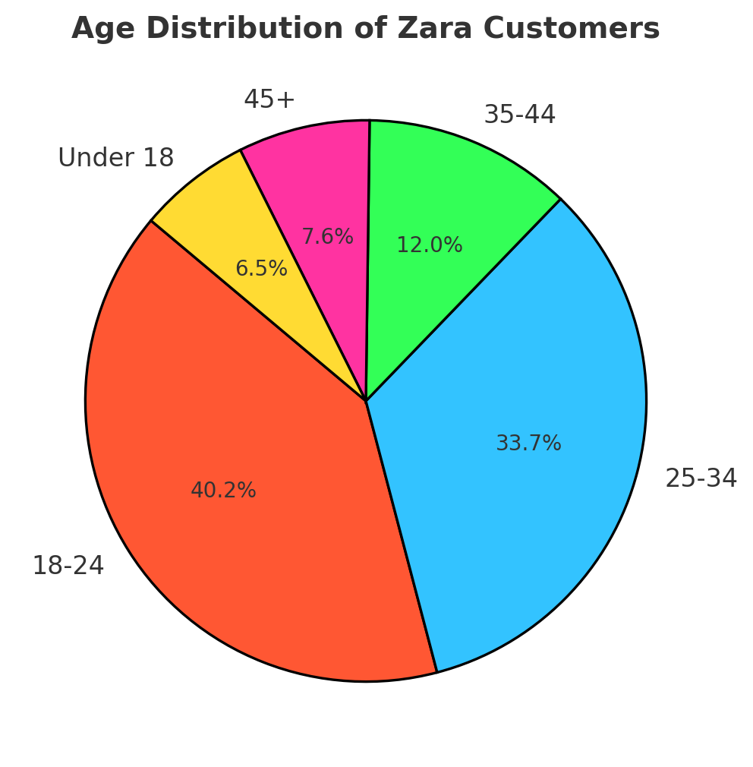
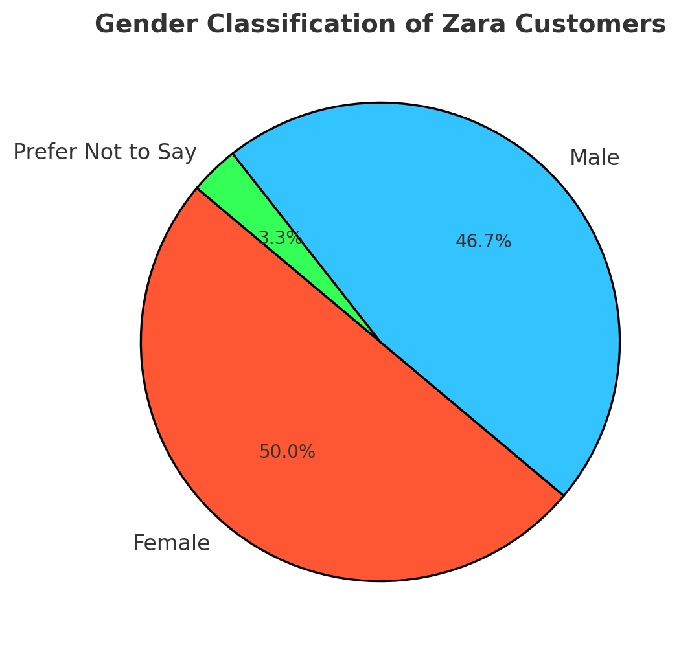
5C ANALYSIS - CUSTOMERS
Customer Profiles
Trend Sensitive, Price conscious shoppers
Quality and Service Oriented buyers
Sustainability focused customers
Size inclusive & Convenience driven Shoppers
Buying Behavior
Digital-first shopping habits
Increased demand for Personalization
Higher Expectation for Eco-friendly and ethical products
Notes:
Zara’s target audience consists mainly of Millennials and Gen Z—young, fashion-conscious, and digitally savvy.
These customers expect more than just style—they expect convenience, personalization, and ethical responsibility. Our research shows that 75% of Zara’s customers engage with fashion influencers on social media, highlighting the importance of a strong digital presence.
Sustainability is also becoming more important—60% of Gen Z shoppers say they prefer brands that demonstrate ethical sourcing and transparency. Size inclusivity is another growing priority, with customers expecting more diverse size options and better fit.
Understanding these behaviors allows Zara to shape a more targeted and effective advertising strategy—one that combines affordability, trendiness, and ethical responsibility.

Slide 6
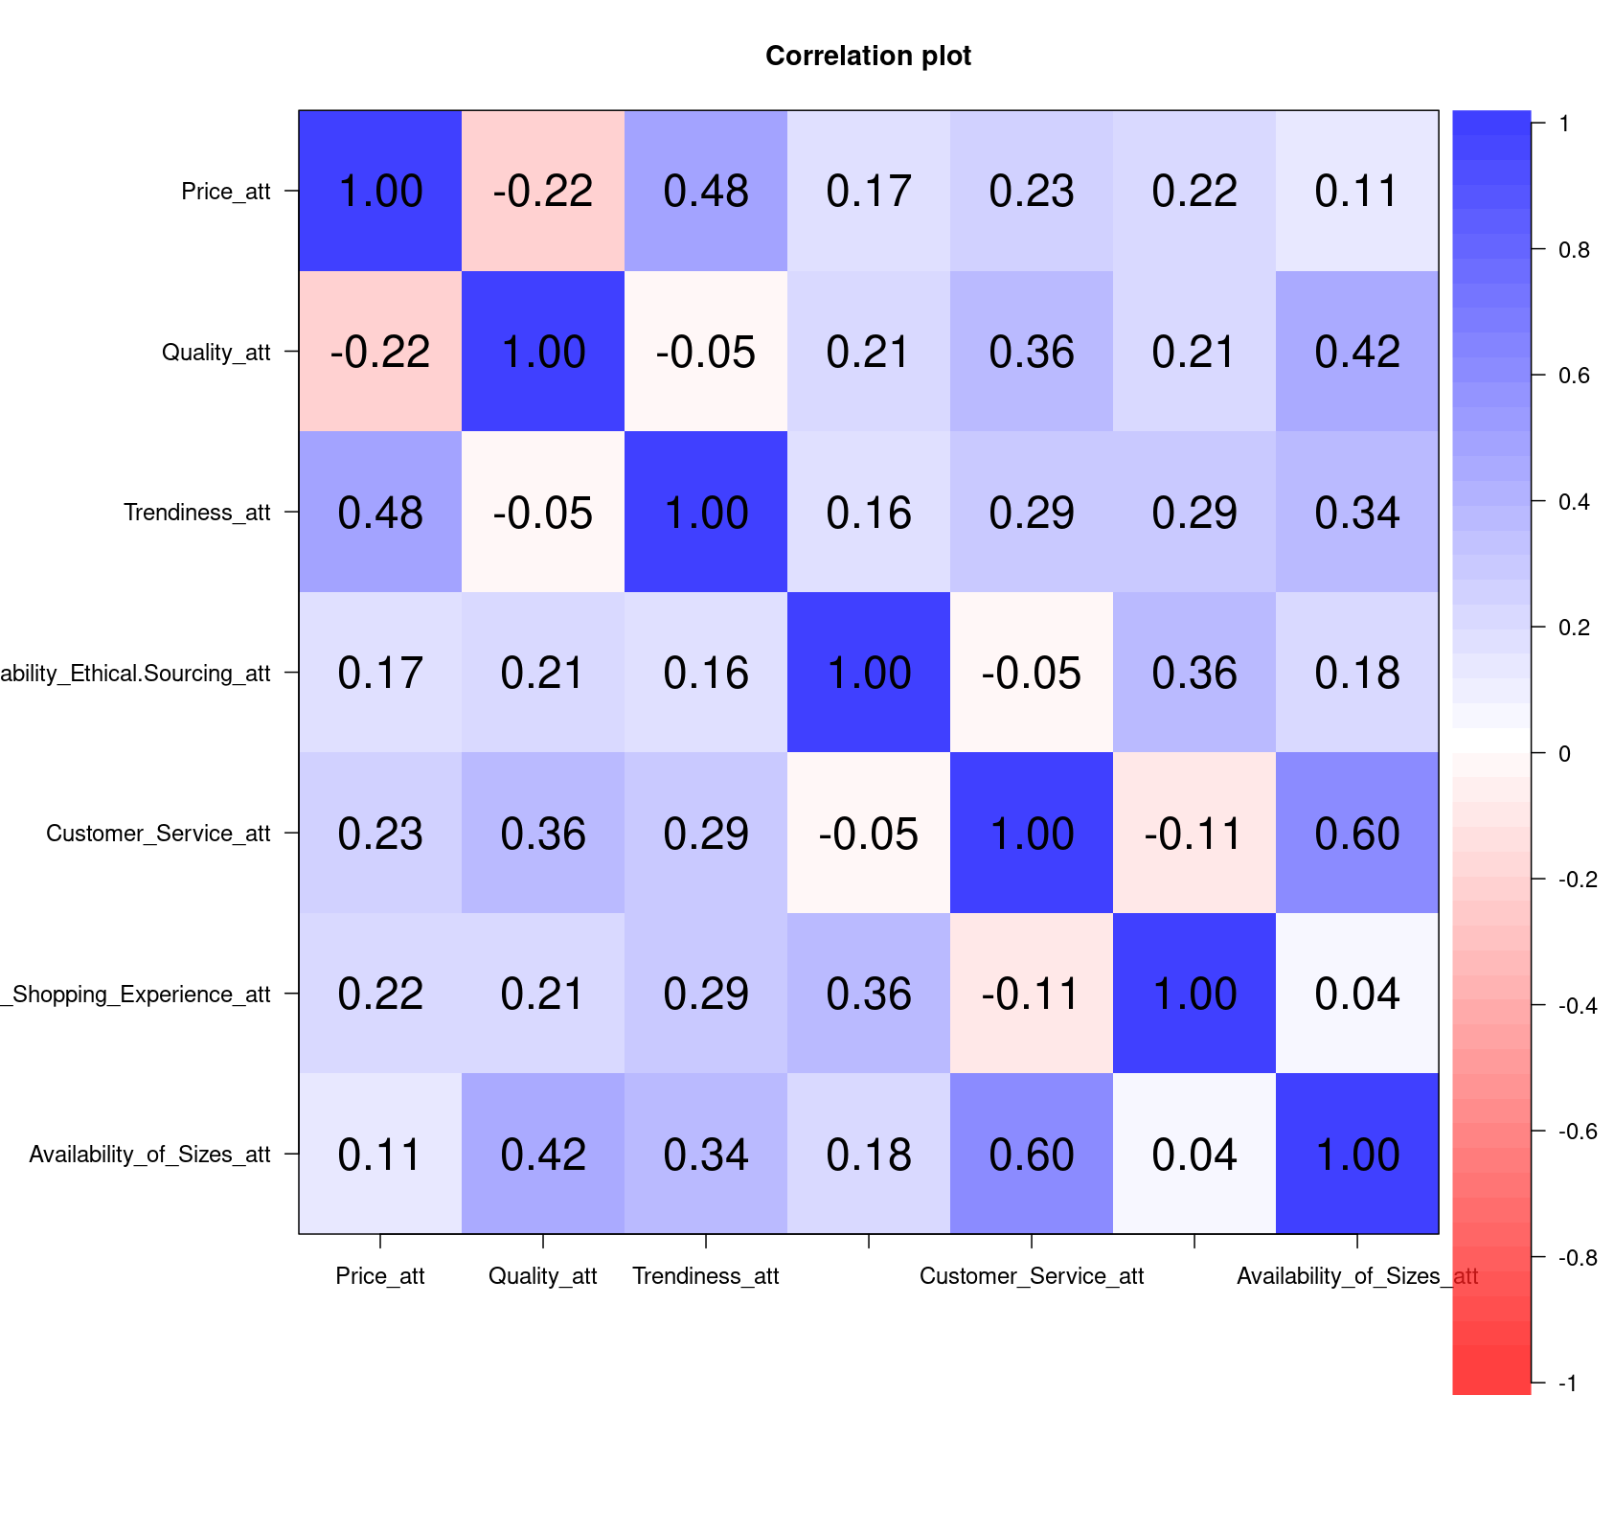
CUSTOMER PREFERENCES & BEHAVIOR TRENDS
Key Insights (82 respondents):
💡 Price & Trendiness Correlation (0.48): Affordable products are seen as more trendy.
💡 Quality & Size Availability Correlation (0.42): Better size range strengthens quality perception.
💡 Sustainability & Online Shopping Correlation (0.36): Eco-conscious buyers prefer online shopping.
Strategic Takeaways:
Highlight affordability and trendiness in campaigns.
Reinforce size inclusivity to improve quality perception.
Promote sustainable collections on Zara’s e-commerce platform.
Notes:
Our survey of 82 respondents provided valuable insights into customer behavior.
We found a clear correlation between price and trendiness (0.48). Customers who perceive Zara as affordable are more likely to see the brand as trendy. This reinforces the importance of competitive pricing in maintaining Zara’s trendy image.
We also identified a correlation between quality and size availability (0.42). Expanding Zara’s size range not only improves accessibility but also enhances the perception of quality.
Finally, there’s a positive correlation between sustainability and online shopping (0.36). Eco-conscious shoppers are more likely to prefer brands with strong online platforms. This means that Zara’s e-commerce site should highlight its sustainable collections more prominently.
These insights underscore the importance of balancing affordability, quality, and sustainability in both product and messaging strategy.

Slide 7
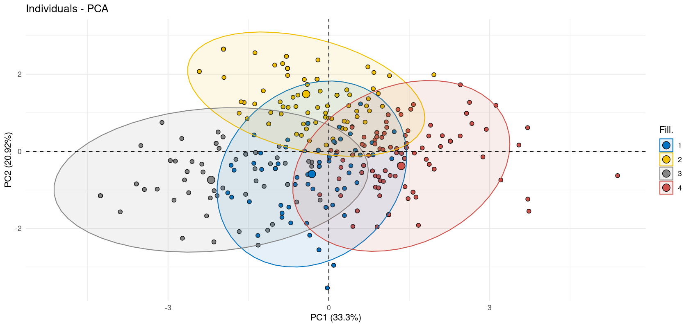
CONSUMER SEGMENTATION ANALYSIS
Trend & Price-Sensitive (35%) – Fast-changing styles, affordability focus.
Quality & Service-Oriented (27%) – Willing to pay more for premium materials and service.
Sustainability & Digital Buyers (22%) – Eco-conscious and digital-first.
Size-Inclusive & Convenience Seekers (16%) – Demand for inclusive sizing and fast delivery.
Notes:
Our cluster analysis identified four key customer segments:
Trend & Price-Sensitive (35%) – This group is motivated by affordability and fast product turnover. Influencer-driven campaigns and frequent product drops are key to capturing this segment.
Quality & Service-Oriented (27%) – Willing to pay more for premium fabrics and customer service. Exclusive collections and membership programs would appeal to this group.
Sustainability & Digital Buyers (22%) – Prioritize ethical sourcing and convenience. Highlighting Zara’s "Join Life" collection and improving the online shopping experience will strengthen loyalty.
Size-Inclusive & Convenience Seekers (16%) – Expect a broader size range and easy shopping experiences. Expanding sizing and improving return policies would appeal to this segment.
Segmenting these groups allows Zara to create targeted marketing and product strategies.

Slide 8
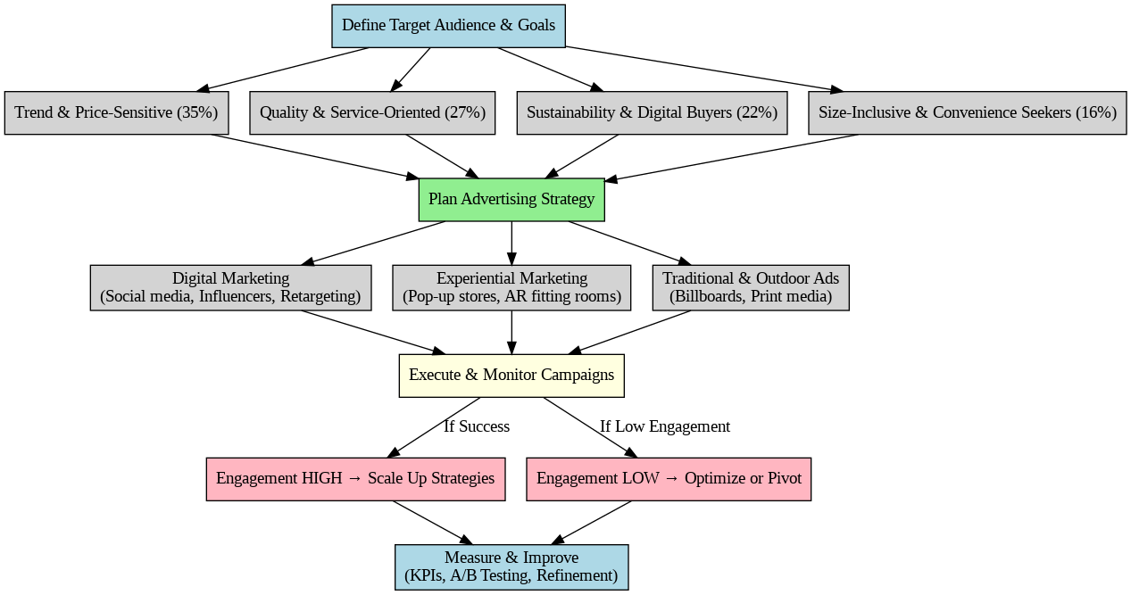
CONNECTING CUSTOMER INSIGHTS TO 5C ANALYSIS
Zara’s fast fashion model suits trend-driven customers.
Eco-conscious practices align with growing sustainability trends.
Digital presence meets customer demand for convenience.
Competitive pressure requires greater differentiation and value proposition.
Notes:
Zara’s fast fashion model suits trend-driven customers, but it risks alienating sustainability-focused buyers.
Digital convenience meets customer demand, but Zara must reinforce its competitive edge against Shein’s pricing and H&M’s sustainability focus.
Balancing affordability with premium product offerings and strengthening sustainable practices will allow Zara to maintain its market leadership.

Slide 9
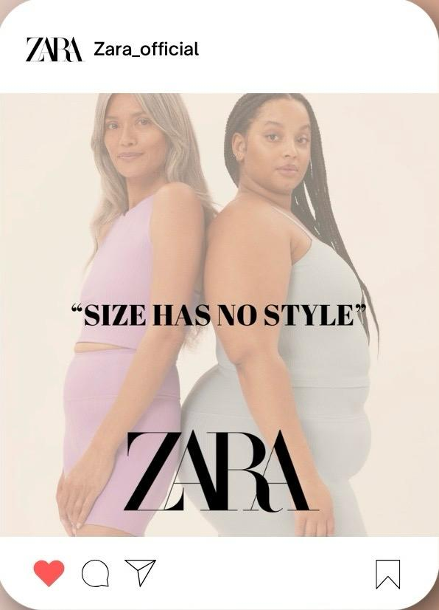
ADVERTISING STRATEGY
Social Media:
Focus on Instagram, TikTok, and Pinterest
Engage through influencer partnerships and AR filters
SEO and Retargeting:
Retargeting based on customer browsing habits
Personalized ad recommendations
Notes:
Zara’s advertising strategy should focus on digital channels:
Social Media: Expand influencer partnerships on Instagram, TikTok, and Pinterest to highlight new collections and styling tips.
SEO and Retargeting: Use AI to personalize recommendations and retarget cart abandoners to increase conversion rates.
Targeted, data-driven advertising will boost customer engagement and retention.

Slide 10
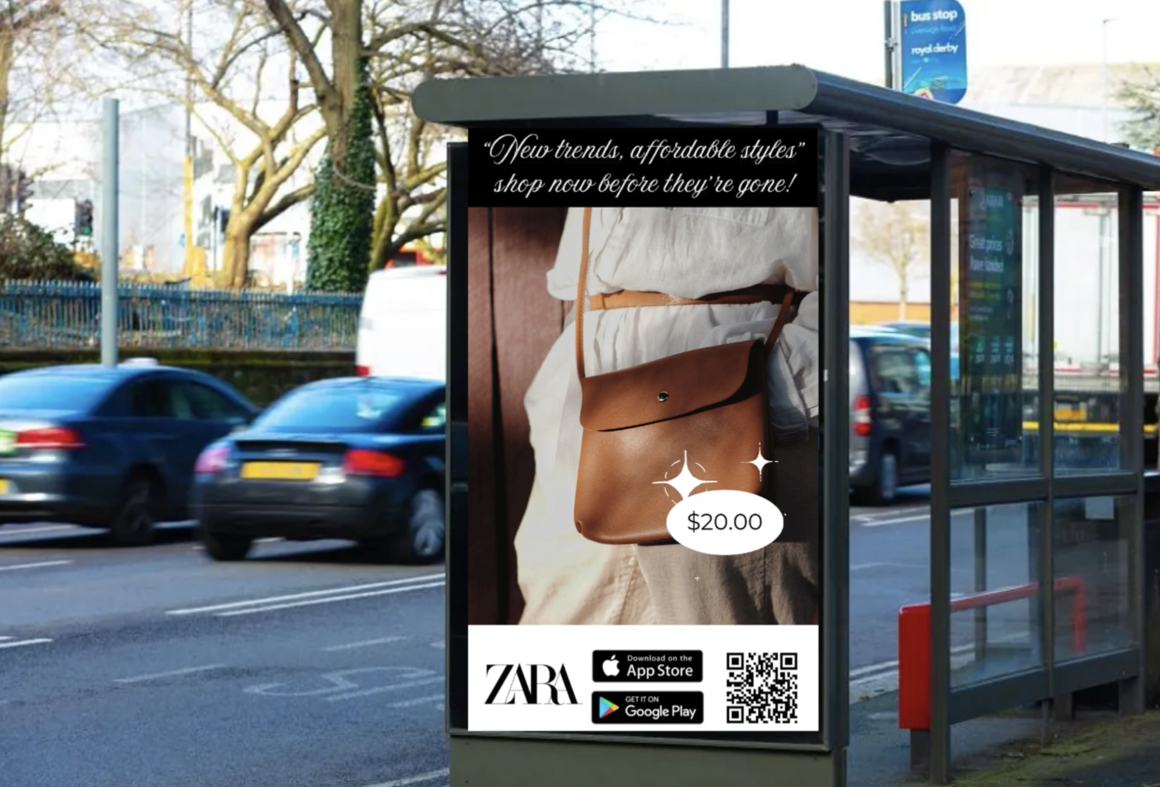
EXPERIENTIAL MARKETING & TRADITIONAL ADS
Pop-Up Stores:
Limited-time events in key markets
AR fitting rooms to enhance customer experience
Traditional Ads:
Billboards in high-traffic urban areas
Fashion magazine placements
Notes:
To complement the digital strategy, Zara should engage customers through experiential and traditional channels:
Pop-Up Stores: Short-term events in key markets featuring interactive displays and AR-based styling.
AR Fitting Rooms: Allow customers to try on outfits virtually to enhance both online and in-store experiences.
Traditional Ads: Reinforce Zara’s premium image through billboards and fashion magazine placements.
This combination creates a balanced customer experience across digital and physical platforms.

Slide 11
STRATEGIC RECOMMENDATIONS - 4P’S
PRODUCT
PROMOTION
PLACE
PRICE
Expand "Join Life," broaden size range, and add personalized products, i.e, customisation
Boost influencer ads, host pop-ups, AI-driven ads, live shopping and maintain billboard presence
Strengthen e-commerce, improve "click-and-collect," Omnichannel integration and introduce AR fitting rooms
Maintain affordable luxury, launch loyalty programs, dynamic pricing, exclusive drops and offer seasonal discounts
Notes:
Our strategic recommendations focus on the 4P framework:
Product: Expand "Join Life" for sustainability, broaden sizing, and introduce personalized products.
Price: Maintain affordable luxury, introduce tiered loyalty programs, and offer seasonal discounts.
Place: Strengthen e-commerce, improve "click-and-collect," and add AR fitting rooms.
Promotion: Focus on influencer campaigns, pop-ups, and targeted advertising to drive engagement.
This ensures a well-rounded strategy that reflects Zara’s customer base and market position.

Slide 12
CONCLUSION
KEY RECOMMENDATIONS
CONCLUSION
Scale successful digital campaigns
Invest more in influencer partnerships
Expand AR fitting rooms and pop-up stores
Optimize based on customer feedback and KPI tracking
Zara’s competitive edge lies in blending fast fashion with digital and experiential strategies.
Notes:
To summarize our recommendations:
Scale successful digital campaigns and invest more in influencer partnerships.
Expand AR fitting rooms and pop-up stores.
Strengthen sustainable messaging and improve customer feedback systems.
By blending fast fashion efficiency with data-driven personalization and sustainable practices, Zara can maintain its competitive edge.

Slide 13
THANK YOU FOR YOUR TIME!
Notes:
Thank you for your time and we hope you have a pleasant day.

